Slide 1
Hotel Management
Project By-
3501- Dhruvi Swadia
3502- Rakshita Bhole
3504- Aman Sinha
3505- Riya Ghosh

Slide 2
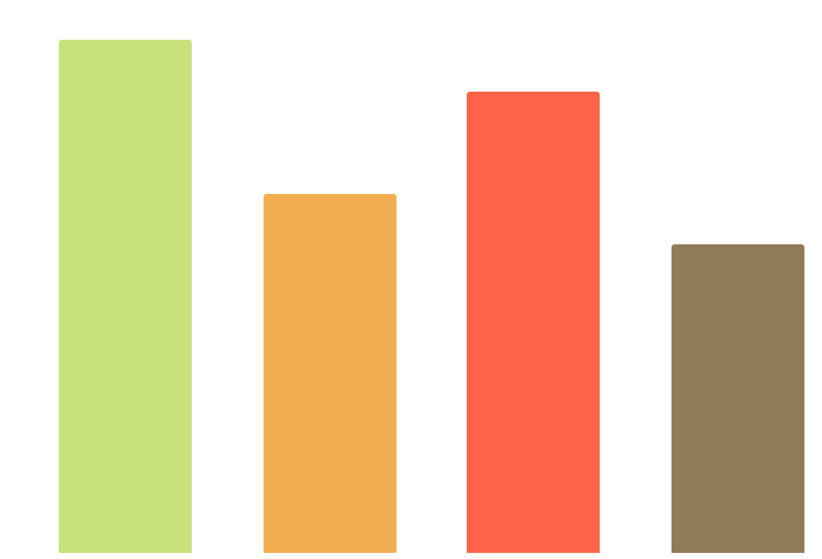
What’s on the menu?
Creating tables, Dashboard
Dhruvi
Introduction, Hotel and Hotel management system, Inserting data
Rakshita
ER Diagram, Conclusion
Aman
Presentation and Queries, converting sql data into excel
Riya

Slide 3
Restaurant Infographics
01
02
I’ll have veg biryani for dinner.
It’s not veg biryani, IT’S PULAV!!
70 %
70 %
30 %
30 %

Slide 4
Importance of Database
Database management has become more important as the volume of business data has grown.
Rapid data growth creates a wide variety of negative conditions, including poor application performance and compliance risk, to name a few.
A database in SQL Server is made up of a collection of tables that stores a specific set of structured data.
50 %
50 %

Slide 5
E-R Diagrams
We propose to build a software project that can efficiently handle and manage various activities of any hotel.
The businesses in hotels are now growing constantly. At the same time, the need for managing its operations and tasks arises.
The best way to optimize it’s database via ER diagrams. An entity relationship diagram (ERD) shows the relationships of entity sets stored in a database.
ER diagrams are used to sketch out the design of a database.

Slide 6
TOP THREE HOTELS IN MUMBAI
4.7 STARS
TAJ MAHAL PALACE
4.7 STARS
OBEROI HOTEL MUMBAI
4.5 STARS
GRAND HYATT MUMBAI

Slide 7
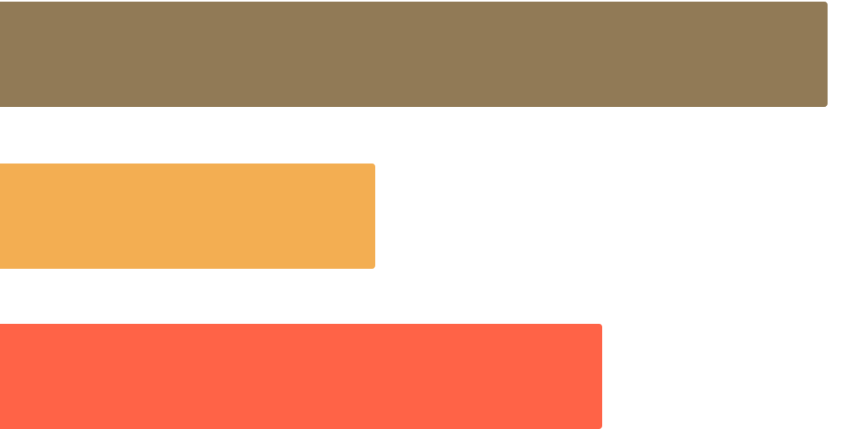
ALL ABOUT QUERIES
Query languages are utilized to make queries in a database, and Microsoft Structured Query Language (SQL) is the standard.
Under the SQL query umbrella, there are a few augmentations of the language, including MySQL, Oracle SQL.
Consequently, various query languages have been created for various database motors and purposes, yet SQL is by a wide margin the most universal and surely understood.

